Slide 1
iTest OverView

Slide 2
History
Initially iTest is a fanfare product and it is named as Fanfare itest tool.
On Feb 16th 2011, Fanfare has entered into a definitive agreement to be acquired by Spirent Communications.
Now iTest tool is named as Spirent iTest.
Spirent is having products like “Networks & Applications, Mobile Devices & Network Equipment, Positioning & Navigation, Products & Services”
Spirent iTest is also one of the Spirent Product.

Slide 3
Introduction about Spirent iTest
Spirent iTest is a stand-alone GUI (graphical user interface) application. It is built using Eclipse and Java, which are supported on many other platforms.
Spirent iTest allows you to Capture, Replay and Extend your manual tests, quickly turning them into automated tests without any scripting language experience.
Powerful functions such as visual output parsing ("response maps") and visual debugging let you handle a number of typically complex tasks with ease.
Spirent iTest provides a path to extend your manual tests with programming logic, either within its GUI or through the use of external procedures and libraries (Tcl APIs).

Slide 4
Icont….
Spirent iTest is an integrated test environment for management interfaces like CLI (Telnet or SSH), Web, SNMP or Tcl API.
iTest automatically captures detailed commands and responses for multiple protocols – allowing users to save these as the basis for a future, fully-automated test case.

Slide 5
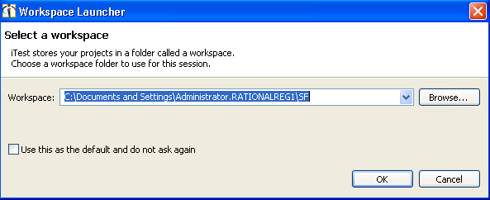
WorkSpace:
Workspace is the folder on your file system that holds the projects in which you'll store all folders and files that you generate using Spirent iTest and the settings associated with your Spirent iTest environment.

Slide 6
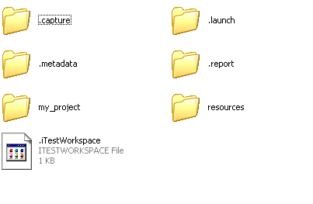
Folders in Workspace:

Slide 7
Licensing
To set up licensing so you can use Spirent iTest, you perform these two simple tasks:
-> Specify the the host computer that runs the license server software
-> Specify which edition of Spirent iTest and its modules to use
Note: Floating licenses are provided by license server software. Information on configuring the server appears in the Spirent iTest Installation Guide (a PDF document that appears in the Spirent Knowledge Base).

Slide 8
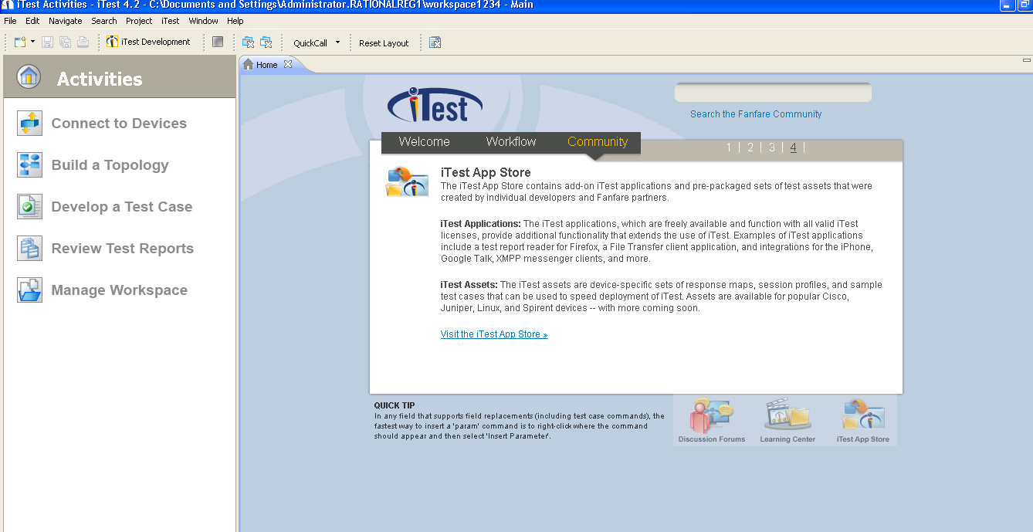
iTest Welcome Page

Slide 9
GUI options
Views
Perspectives and Custom perspectives
Projects
Configuring Preferences
Export and Import projects
Editors
Session profile
Test bed

Slide 10
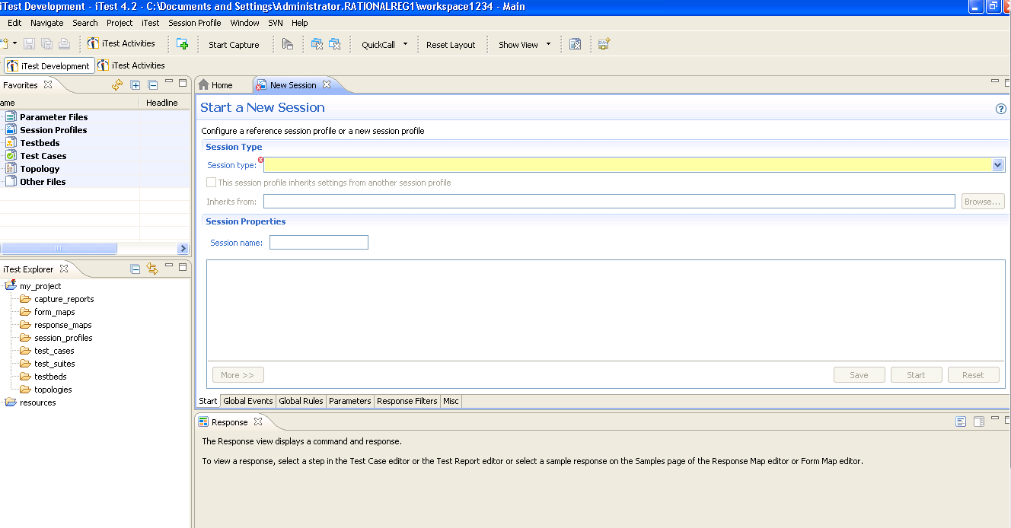
iTest Development

Slide 11
Session Profiles
Below are the list of session profiles we are supporting in iTest.
Total 33 session profiles are supporting.
Command Prompt | Rest | Spirent TestCenterCLI | VMWare
Database | Process | SmartBitsSTC-NTAF | VNC
Flex | RFT Launcher | SSH | Web Services
File | Script Library Support | Swing | Wireshark
HTTP | Serial | Syslog | XML-RPC
IxIA products | SNMP | TCL Shell | Image Processing
Landslide | Spirent Avalanche | Telnet | Agilent N2X
Mail | Spirent TestCenter | UDP

Slide 12
Defining a Session Profile
Whenever the Session Profile editor is selected, the Session Profile menu appears in the menu bar. The options that appear in the menu vary depending on the editor page in use.
Click to open the Start page of the Session Profile editor.

Slide 13
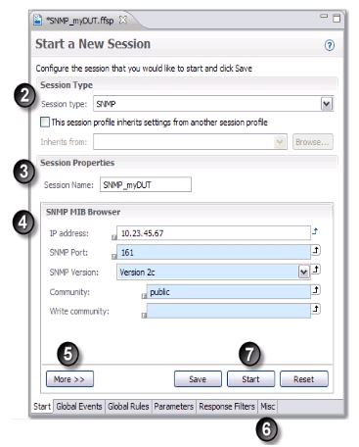

Slide 14
Select the session type you want to test or use
Choose a name to save the session profile
Provide the details of the session to connect to the session
More contains additional properties to the session which you have selected.
Optional. It contains reference session profile which inherits the session.
Save and start the session to connect the device

Slide 15
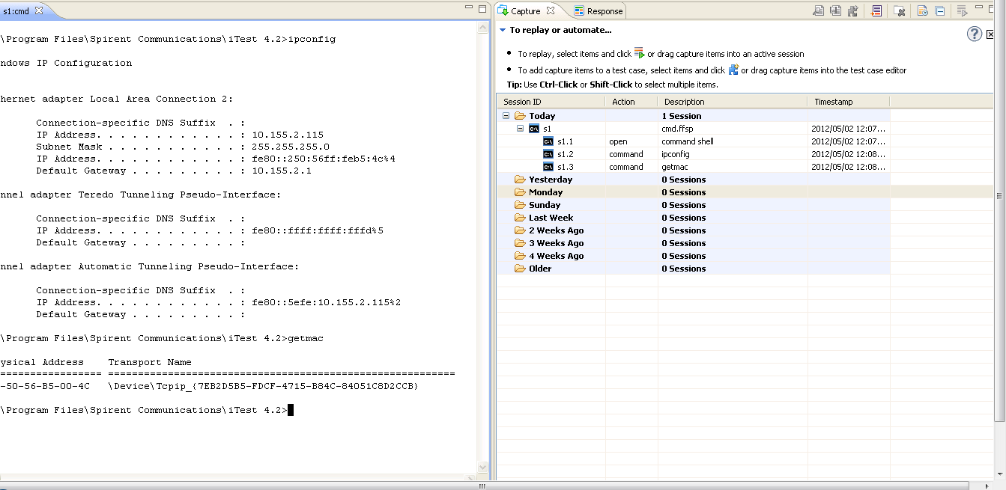
Capture View

Slide 16
Testcase Authorizing
Create a new test case or open an existing test case
Adding steps by capturing (start sessions with devices and save the captured steps into the test case)
Adding analysis rules that validate a value in a response or store it into a variable
The Steps page is the most important. It lists all of the steps and analysis rules in the test case and shows the flow of execution.
The Test Case editor does more than allow you to configure a test case. It also links the test case to the last associated capture and/or test report and uses the information to update related views (such as the Response, Structure, Queries, and Step Issues views) when you select a particular step. Information on the response for the last execution appears in the views.
Execute the test case

Slide 17
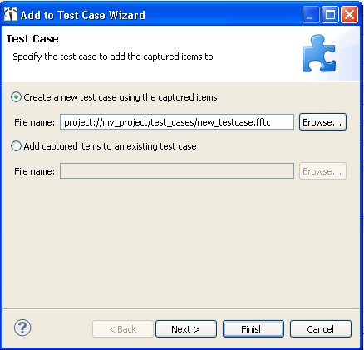
Testcase

Slide 18
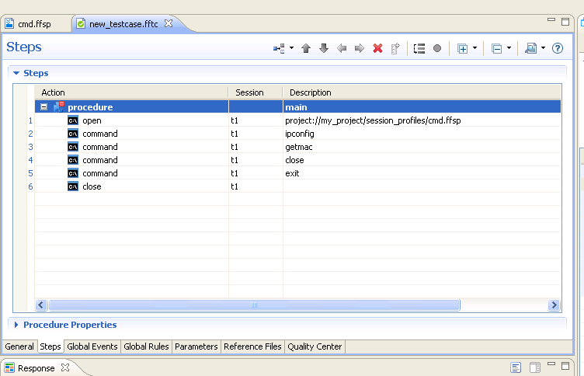
Testcase Editor

Slide 19
Replay
Replay is a feature in iTest to know the failures in the captured testcase.
Top of the iTest Development perspective, we have small green color arrow mark used to execute the testcase and make sure to know the result.

Slide 20
Analysis Rules
Adding an Analysis to a steps in a testcase which validates the response all the time in each execution.
Step Properties
For every step we have properties and we change accordingly
Procedure Properties
Testcase contains ‘n’ no.of procedures but entry point should be only one.
To change the properties of the procedure, we are using procedure properties tab

Slide 21
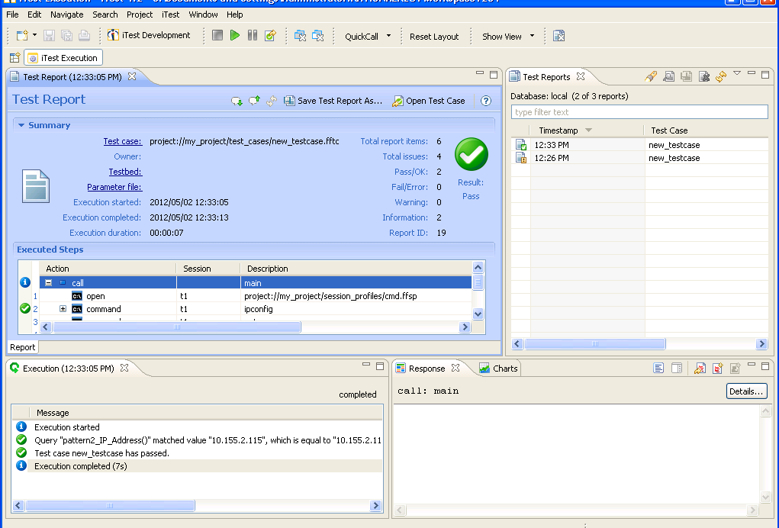
Test Report Editor

Slide 22



Result in TRE
Indeterminate: If testcase doesn’t have any validation, test case will give result as Indeterminate.
Pass: Testcase is have valid analysis rule and execution doesn’t have any errors, the result is Pass.
Fail: If testcase contains any errors or mismatch analysis rules, result is Fail.

Slide 23
Substitutions
Variables: Passing a variables with in procedures or different procedures. Local and Global Variables.
Parameters: Substituting a parameters in place of value.
Arguments: Arguments mainly used for the time of calling procedures in another testcase and passing the values

Slide 24
Test Report Generation
Spirent iTest lists all available test reports in the Test Reports view and displays the details of a test report in the Test Report editor.
From the Test Report editor or Test Reports view, you can save test reports into HTML, XML, or text formats.
We can export test reports into a file suitable for import into other Spirent iTest workspaces.
We can configure auto-export so that test reports are saved into a specified format whenever execution ends.
We can use External test report Database (MySQL).

Slide 25
Few Terminologies
Test report: Result of the testcase we can save in the html, xml, Text and xml_raw.
Response Mapping: It is an advance Analysis Rule for the response.
Testbed: Collection of Session profiles.
Topology: Pictorial representation of the session profiles
Windows -> Preferences: It is global settings of itest.

Slide 26
Topology Editor & QuickCalls
We use the Topology editor to define all of the physical devices, cards and interfaces on the devices, links between devices, and session configurations defined for devices.
A topology document is a collection of the information that test cases need to access the devices and sessions (for example, the IP address of the device and login information). Each session configuration is based on a default Spirent iTest session type (such as Telnet, Web, SNMP, and so on) or on a session profile.
Spirent iTest creates TBML-format files (file extension .tbml)
QuickCalls are custom actions that we define for a session profile or device. QuickCalls make it easy to execute a predefined set of steps — either as a single QuickCall step in a test case or as a single button click in an interactive session.

Slide 27
Test suites & Job scheduling
A test suite contains one or more groups of tests. Each test group contains one or more test cases.
When you define a test suite, you can specify that each test group should execute in a specified order or concurrently (in parallel) and timeout limits.
Test Suite editor is used to specify which test cases should be members of each test group and which test groups make up a test suite.
Define an Spirent iTest job that references the test suite. When the job runs, the test suite executes.

Slide 28
iTestRT/iTestCLI
iTestRT
iTestCLI
iTestRT is the command line (or “headless”) version of Spirent iTest that can operate on any Spirent iTest files whether or not they are held in a Spirent iTest workspace
Example:- “To Execute A Test-Case”
itestrt --test <testCaseFile>
iTestRT supports test suites execution
iTestCLI is the original implementation of the command line (or “headless”) version of Spirent iTest. iTestCLI can operate only on Spirent iTest files that are held in a Spirent iTest workspace
Example:- “To Execute A Test-Case”
itestcli -w workspace_dir test_case_URI_or_path
iTestcli does not support test suites

Slide 29
CLI and RT
CLI and RT are mainly used for regression testing. Executing testcase and testsuites through command prompt not in GUI
CLI – Command Line Interface: Help command will show all the options to execute the testcase etc.,
RT – RunTime: Before executing the testcases, need to export all the files in to an itar folder.

Slide 30
Extensions
Session profile - .ffsp
Testcase - .fftc
Testbed - .fftb
Topology - .tbml
Capture report - .ffcz
Test report - .fftz
Job - .ffjd
Test suite - .ffts

Slide 31
THANK YOU

